Slide 1
Keras Stock Predictor
PRESENTED BY: SANKET MISHRA, ERIC HAGEE, MEENAKSHI KAVASERI, SHAGUFTA ZAREEN, AND BRIAN KLOVERT

Slide 2
Mission and Vision
Mission: Predict Stock Market trends over the span of 6 months based on 2 and a half years worth of stock data
Predict Variable: The daily close price of each Dow Jones stock
Input Variables: Previous day’s open, high, low, and close price
Vision: Visualize a graph that shows the profitability of each stock included in our dataset by analyzing the close price of a stock over the span of 2 and a half years

Slide 3
Steps Taken
Filtering the 30 CSV files
Create and Test the models
Run the models and predict close values
Analyze the results based on actual close values
Find the best model based on accuracy
Apply that model to all stocks
Visualize our model’s stock predictions

Slide 4
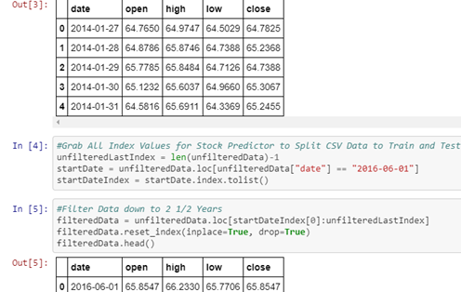
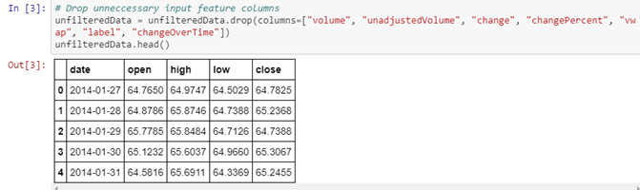
Filtering CSVs
•Dropping rows that weren’t relevant to our analysis
•Volume, Unadjusted Volume, Change, Change Percent, Vwap (volume weighted average price), labels, change over time
•Filtering data down to 2 and ½ years

Slide 5
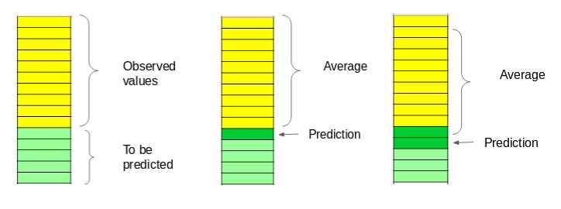
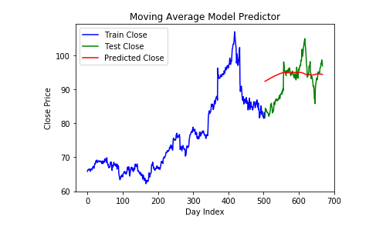
Moving Average Model
Notes:
The first model we created was the Moving Average Model. This model looks only at the close values. It takes all the close train values and averages them. It uses this average to predict the first prediction point. That first predicted point is then added back into the average and the new average is used to predict the second point and so on. As you can probably assume, this model was not very efficient at predicting the test values.

Slide 6
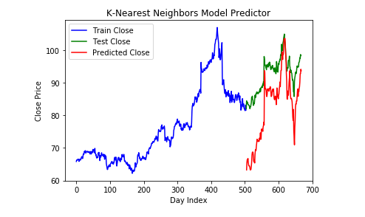
K-Nearest Neighbors Model
Notes:
The next model we used was the K-Nearest Neighbors Model. As we talked about in class, the KNN Model looks at the n closest values to it to determine the trend line. This model was crossvalidated and passed odd-value neighbor parameters of 3,5,7, and 9. The KNN model then chooses the parameter that best fits the data. As you can see, the predict line is more accurate that the Moving Average but still varies from the actual close.

Slide 7
Auto-ARIMA Model
ARIMA models take into account the past values to predict the future values
Three important parameters in ARIMA:
p (past values used for forecasting the next value)
q (past forecast errors used to predict the future values)
d (order of differencing)
Auto-ARIMA automatically parameter tunes the best combination of p,q, and d

Slide 8
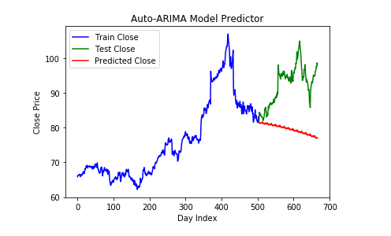
Auto-ARIMA Model
Notes:
Unfortunately, even the best fit parameters of p,q, and d were terrible at predicting the actual close values.

Slide 9
Deep Learning Model
Instead of predicting exact values, this categorical model predicts ranges
The range was split into 19 bin values (18 bin groups) and then used to encode the closing stock prices.
The model was able to accurately categorize 74.8% of the test values, but...
When predicting labels instead of values, you innately lose forecast accuracy

Slide 10
Classification Models
Classification vs. Prediction
Classification represents determining a categorical class for an element included in a dataset
Tendency to overfit
Prediction is about predicting a missing element of a dataset
Profitability (tomorrow’s Close) in the case of our project
Other Classification Models Attempted:
Logistic Regression
Support Vector Machine (SVM)

Slide 11
Benefits of Long Short-Term Memory Neural Network Model (LSTM)
Capability of bridging long time lags between inputs
Bridged 30 day time periods over 2 years of stock data to predict profitability
Recurrent Neural Networks have loops which allow the network to store memory
The LSTM model actively changes the weights of old and new input values based on their relevance

Slide 12
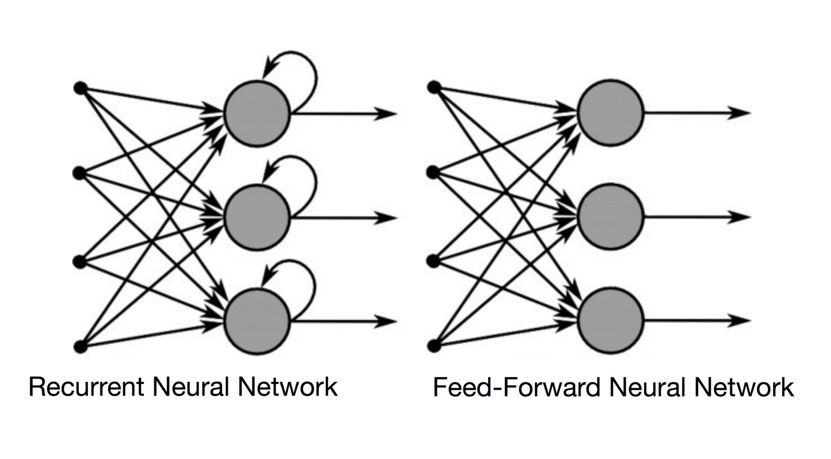
LSTM Model
LSTM internal details are more complex than a normal RNN, too difficult to explain here
Fed open/high/low/close (normalized by training set) prices for a number of days to predict a future close point
Settled on two LSTM layers with 128 neurons each (with dropout layers after), a dense layer of 16 ReLU neurons, and a single linear output
Image from https://towardsdatascience.com/recurrent-neural-networks-and-lstm-4b601dd822a5

Slide 13
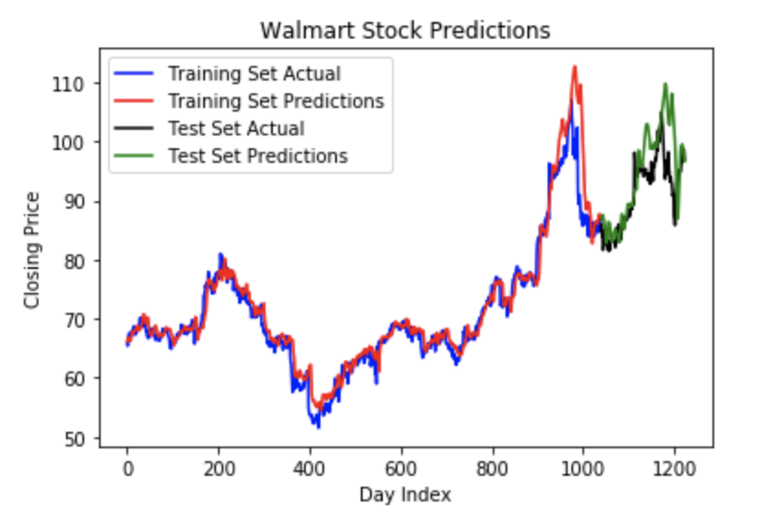
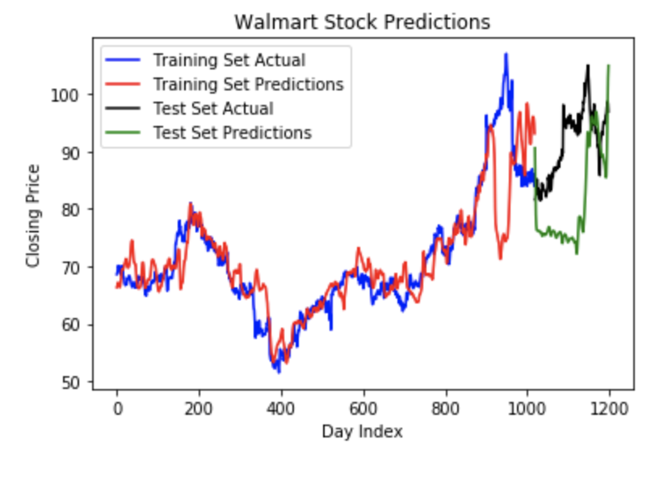
LSTM Model
30 Days data to predict 30 Days data to predict
5 days in future 30 days in future
RMSE 0.24 (Normalized) RMSE 0.47 (Normalized)

Slide 14
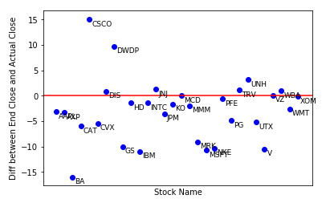
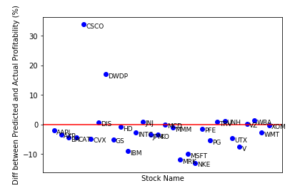
Overview
Stock Market is incredibly hard to predict. The model is not able to accurately forecast for the entire market or for long future points
Notes:
When looking at the Stock Market overall instead of individual stocks, predicting the close values accurately for the entire market is much more complicated and difficult to predict. When we used the 30 day window, 5 day future point, it still varied greatly between individual stocks. The red line here signifies the One limitation of using ML to predict stocks is that the model isn’t able to forecast factors that could affect the market itself. Additionally, as you predict close values further ahead in the future, you start to lose accuracy.

Slide 15
Questions?

